Slide 1

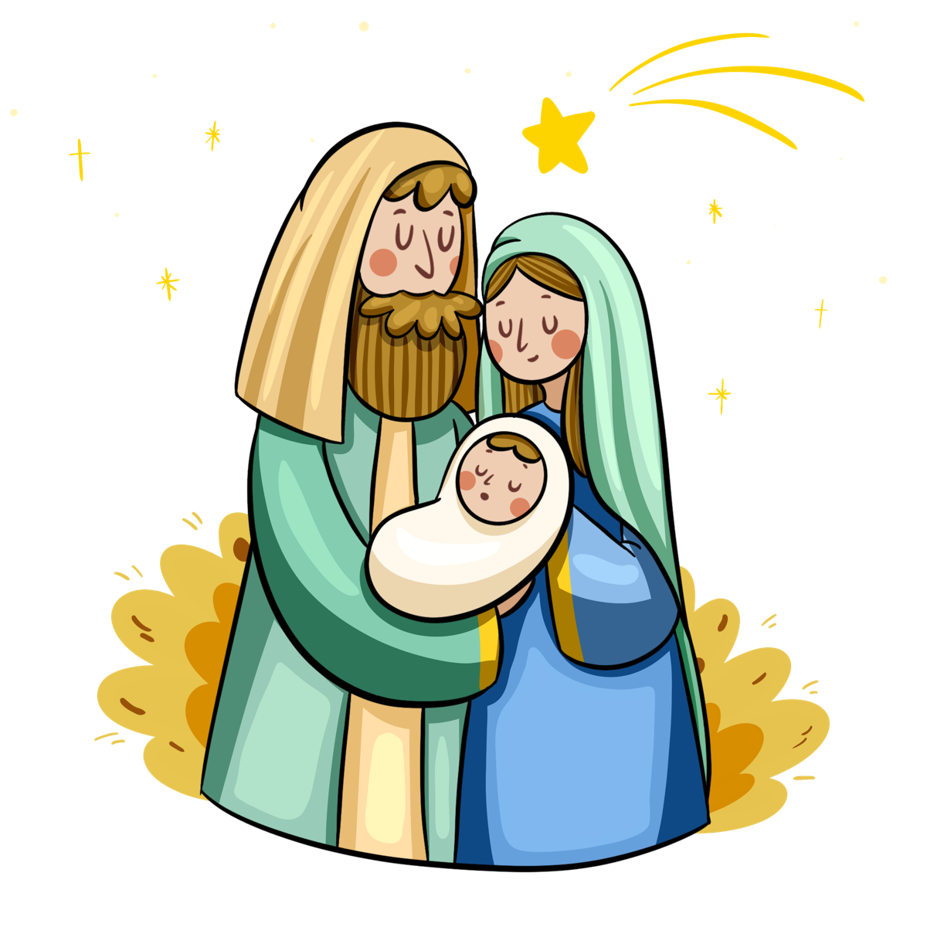
Mrs. Vicari’s
Homeschool News
December 2025
You are the light of the world. Mathew 5:14
History
Science
Early American Christmas
Daniel Boone and the French and Indian War
School during colonial times
The birds of the Twelve Days of Christmas
All about the planet Mercury
Christmas themed science fun
Geography
Music
Delaware and Maryland
Virginia and West Virginia
Review of all states covered so far
Away in a Manger, a lullaby
Carol of the bells, introducing handbells
Little Drummer Boy, introducing drums
Bible
Art
Joshua 1:9 (spider)
James 1:12 (mountain goat)
The Christmas story
• Caravaggio: Narcissus, Value
• Michelangelo: Sistine Chapel Ceiling, Color Theory
• Botticelli: Nativity, Composition pt 2
Other
Skip counting 3’s, 4’s, 5’s (continuing our review)
Nature Study: Canada Goose, Cardinal

